Slide 1
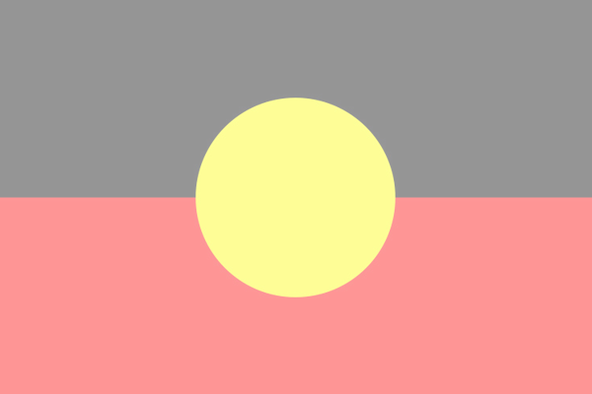
Aboriginal Australian Words and their Etymology
Mr Leslie & the students from Room 14
Ashfield Primary School
© Department of Education, Western Australia
https://creativecommons.org/licenses/by-nc/4.0/

Slide 2
PowerPoint is best viewed with the font ‘McLaren’. This font can be freely downloaded from Google Fonts

Slide 3
Please advise us if our creation requires correction. Care was taken when researching these words, however, we cannot rule out any mistakes during the process of creating this document. Care has also been taken to use creative commons material and cite wherever possible.

Slide 4
Ashfield Primary School

Slide 5
Etymology Inspiration
Paul from the LangFocus channel on YouTube. https://www.youtube.com/channel/UCNhX3WQEkraW3VHPyup8jkQ

Slide 6
Background
As part of our spelling program at Ashfield Primary School, we study the etymology of our spelling list words. Etymology is defined as ‘the study of the origin of words and the way in which their meanings have changed throughout history’.
During these lessons we learnt about the fascinating history of the English language. The English language is influenced by many different languages. The four major languages that have influenced it the most are: Latin, Greek, German and French. Whenever a new group of people (Norse, Anglo-Saxons, French, Romans etc) came to England, they bought their language with them. Over time, all of these new language groups were integrated into the English language. The movement of people thousands of years ago had a profound effect on the language we speak today.
To illustrate this point, beef is French and cow is German. Two different words from two different cultures about a similar concept.

Slide 7
Background
After learning about this rich history, the classroom began to wonder about an interesting question.
What about the etymology of Aboriginal languages and how they have spread across Australia?
Where does Kangaroo come from? Where does quokka come from? How did these Aboriginal words spread across all of Australia?
To investigate this question, we decided to explore the etymology of Aboriginal words for Australian animals. We looked at a list of Aboriginal words that are commonly spoken by all Australians, and then we researched which Aboriginal group first spoke these words.

Slide 8
Background
For example kangaroo comes from the Guugu Yimidhirr people in Queensland and quokka comes from the Noongar people of Whajuk country, Western Australia.
Then we tracked the location of these words on the Aboriginal Australia map. Most of the words were located on the East Coast of Australia. A partial explanation for the spread of these words were a result of the exploration and colonisation of Australia by Europeans, particularly the English. While some individual words have spread widely, many Aboriginal language groups are at risk of becoming extinct or are now extinct.
Finally, we investigated whether these Australian animals also have an equivalent name in Noongar. From the 23 words we investigated, 9 have a Noongar equivalent. Some animals/plants only have a Noongar word because they are native to Whajuk country, Western Australia.

Slide 9
Background
At the completion of these lessons, we learnt that there are many alternative Aboriginal names for Australian animals and that they come from a variety of Aboriginal countries. Lastly, we began to wonder about another question,
If we know that egg is originally a Norse word in origin, shouldn’t we also know the origin of kangaroo?
Of course we should. Everyday we speak Aboriginal words without necessary knowing the history behind these words, so it’s important that we change this.
That’s why we hope that this work will spark inspiration across schools throughout Australia and encourage them to explore the rich etymology of Aboriginal Australian words.

Slide 10
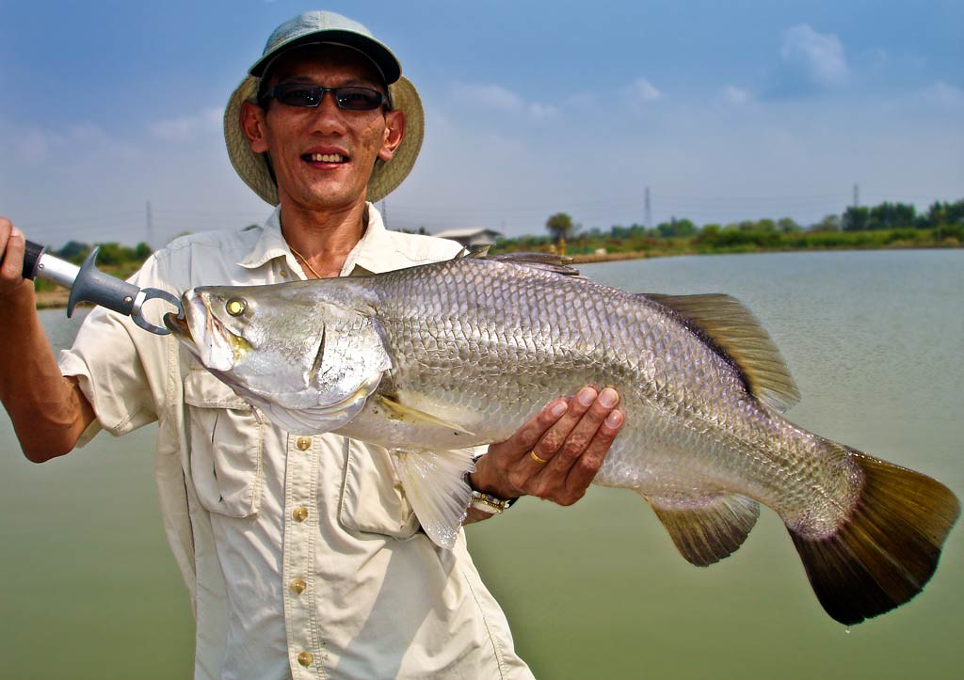
Barramundi
Aboriginal group of origin: Darumbal
Part of Australia:
Rockhampton, Queensland
Alternative Noongar spelling: not native to Wajuk country.
Part of speech: Common noun, animal.

Slide 11
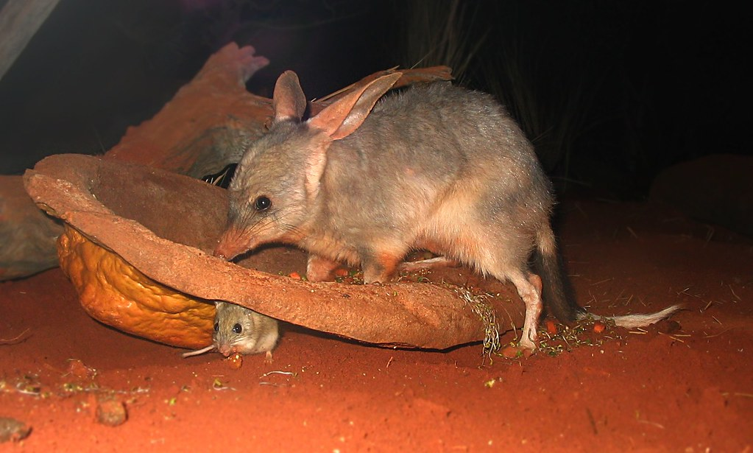
Bilby
Aboriginal group of origin: Gamilaraay.
Part of Australia: New South Wales & Queensland.
Alternative Noongar spelling: not native to Wajuk country.
Part of speech: common noun, animal.

Slide 12
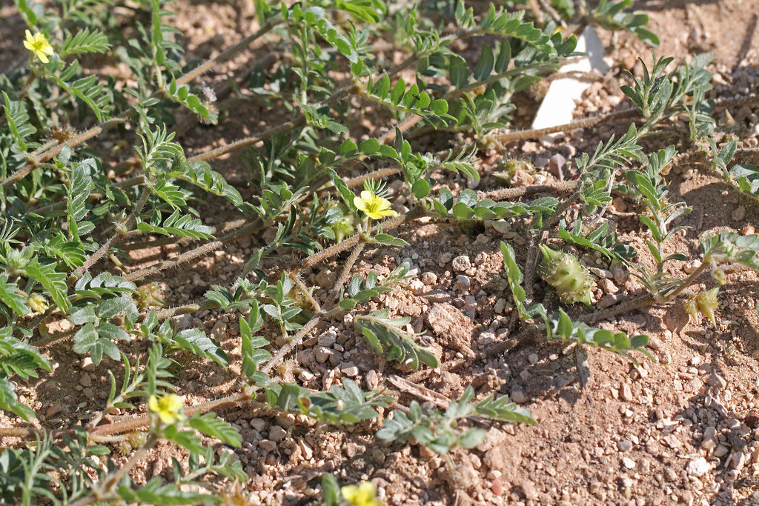
Bindii
Aboriginal group of origin: Gamilaraay.
Part of Australia: New South Wales & Queensland.
Alternative Noongar spelling: uncertain if there is an alternative.
Part of speech: common noun, plant.

Slide 13
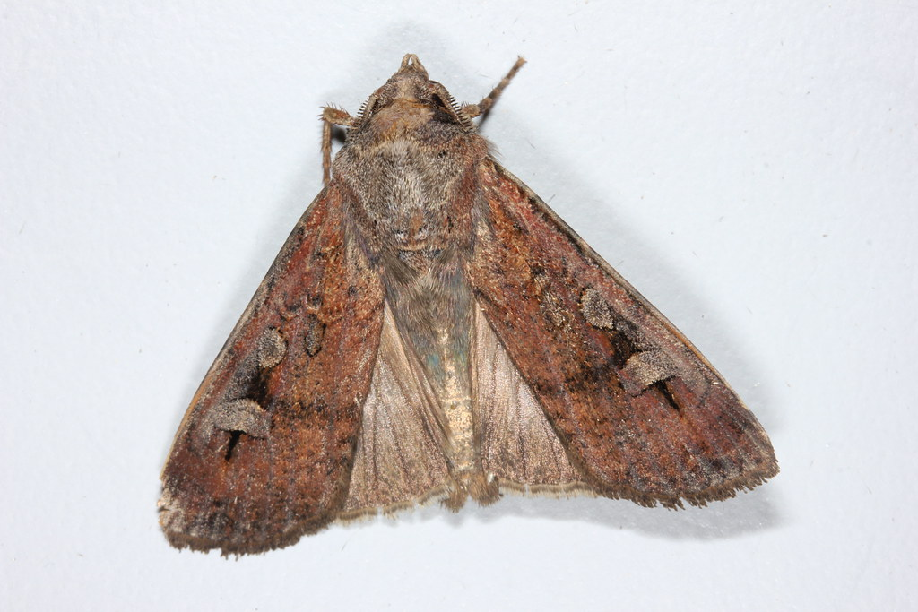
Bogong
Aboriginal group of origin: Dhudhuroa (Ngarigu)
Part of Australia: ACT, Victoria & New South Wales
Alternative Noongar spelling: uncertain if there is an alternative.
Part of speech: common noun, animal.

Slide 14
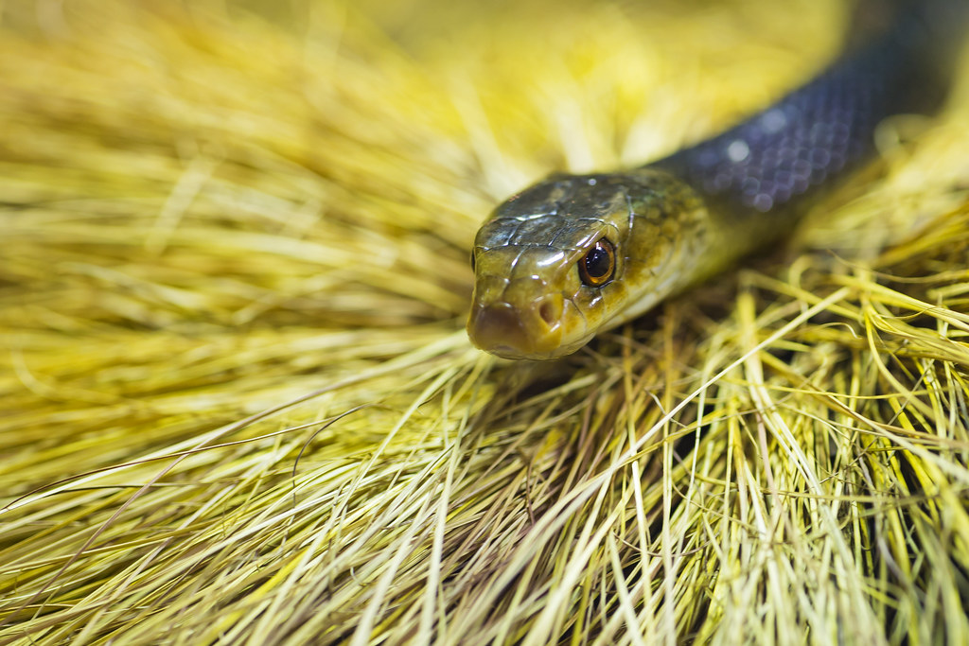
Taipan
Aboriginal group of origin: Wik-Mungkan people.
Part of Australia: Queensland.
Alternative Noongar spelling: not native to Wajuk country.
Part of speech: common noun, animal.

Slide 15
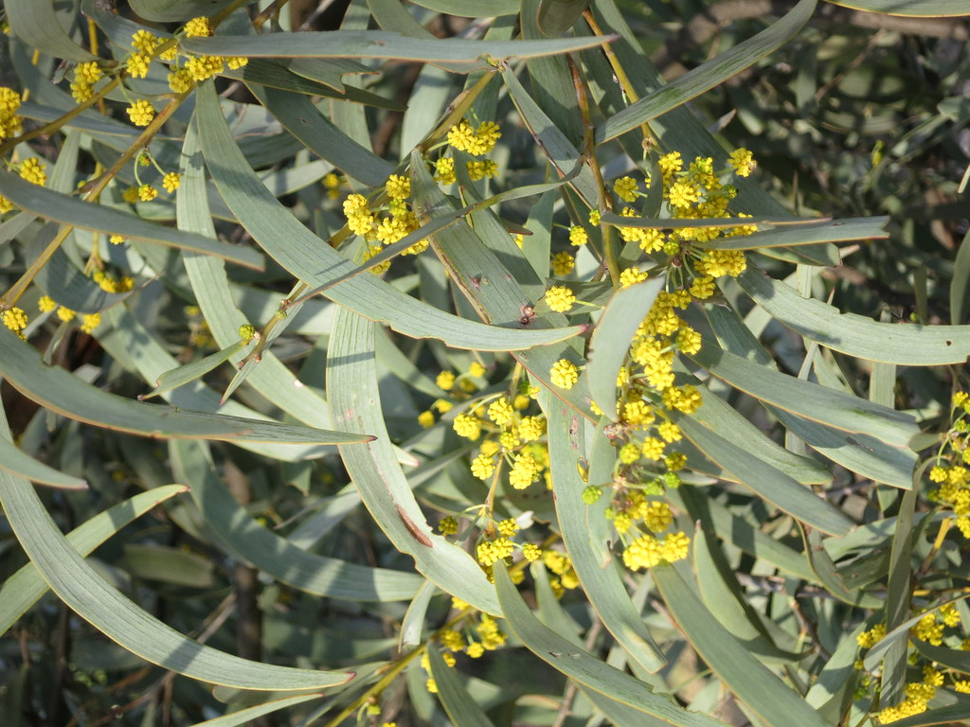
Brigalow
Aboriginal group of origin: Gamilaraay.
Part of Australia: New South Wales & Queensland.
Alternative Noongar spelling: not native to Wajuk country.
Part of speech: common noun, plant.

Slide 16
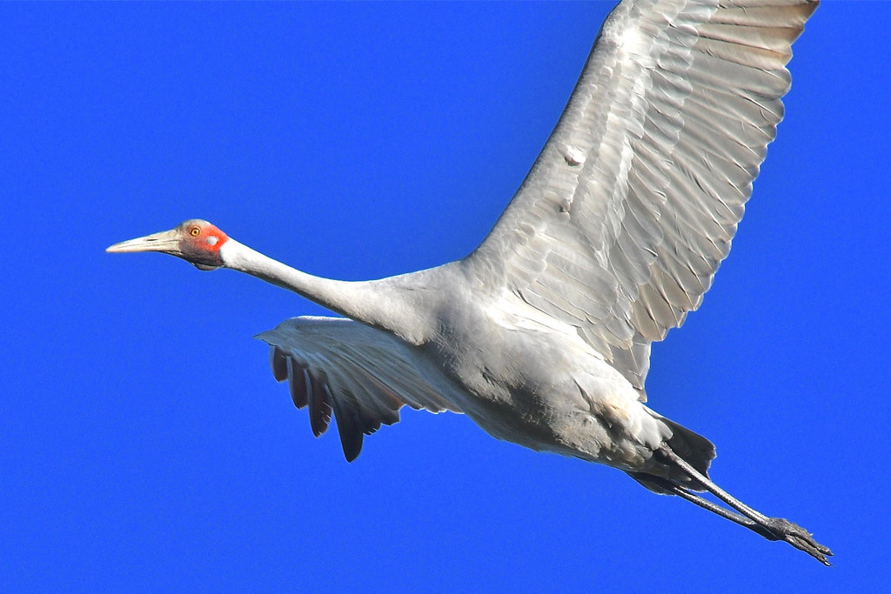
Brolga
Aboriginal group of origin: Gamilaraay
Part of Australia: New South Wales & Queensland.
Alternative Noongar spelling: burralga
Part of speech: common noun, animal.

Slide 17
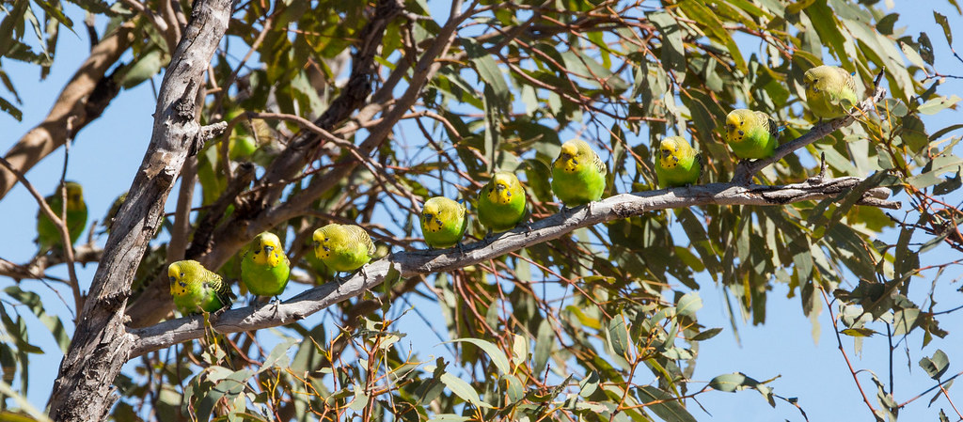
Budgerigar
Aboriginal group of origin: Gamilaraay.
Part of Australia: New South Wales & Queensland.
Alternative Noongar spelling: uncertain.
Part of speech: common noun, plant.

Slide 18
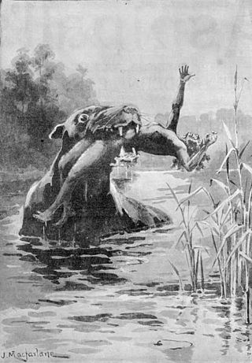
Bunyip
Aboriginal group of origin: Wemba-Wemba.
Part of Australia: Victoria.
Alternative Noongar spelling: n/a.
Part of speech: common noun, mythical creature.

Slide 19
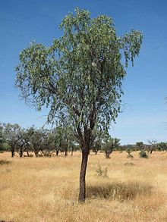
Burdardu
Aboriginal group of origin: Marra (uncertain).
Part of Australia: Northern Territory.
Alternative Noongar spelling: not native to Wajuk country.
Part of speech: common noun, plant.

Slide 20
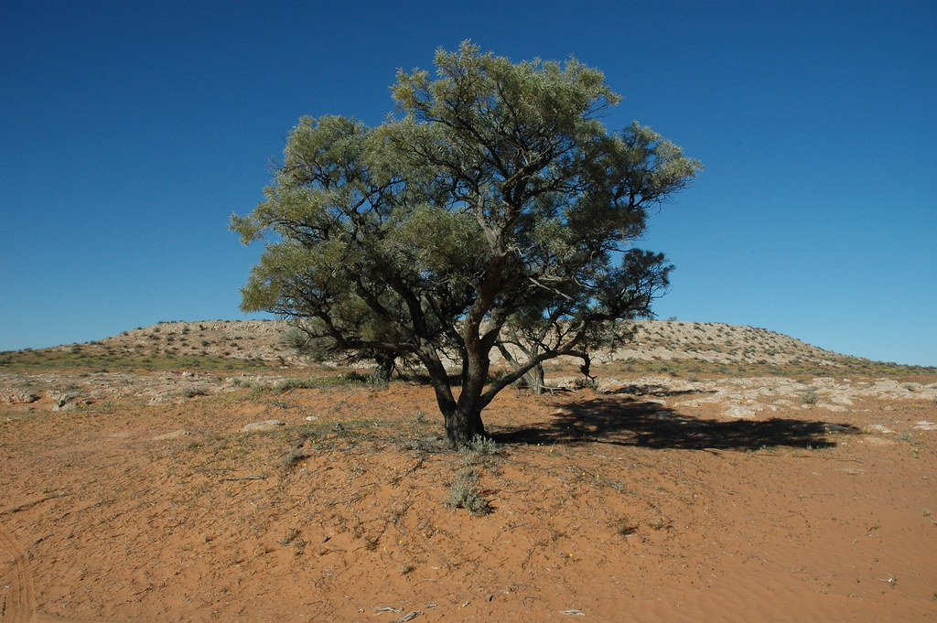
Coolabah
Aboriginal group of origin: Gamilaraay.
Part of Australia: New South Wales & Queensland.
Alternative Noongar spelling: not native to Wajuk country.
Part of speech: common noun, plant.

Slide 21
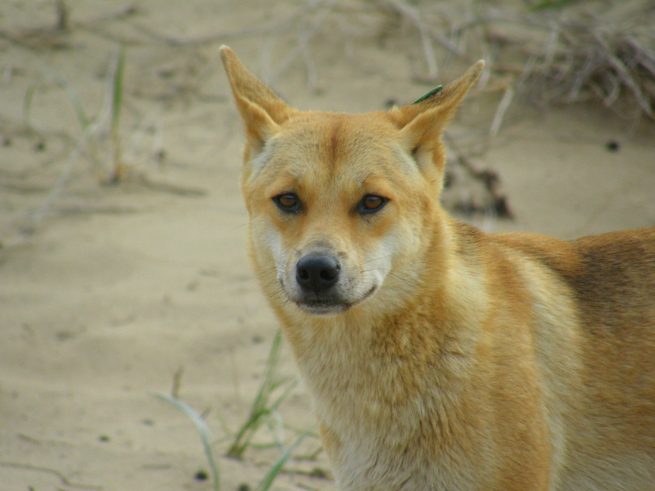
Dingo
Aboriginal group of origin: Dharug.
Part of Australia: New South Wales.
Alternative Noongar spelling: Yokine.
Part of speech: common noun, animal.

Slide 22
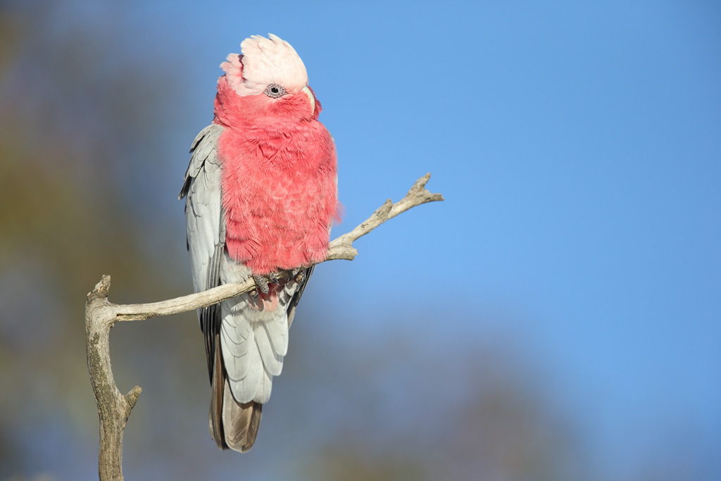
Galah
Aboriginal group of origin: Gamilaraay.
Part of Australia: New South Wales & Queensland.
Alternative Noongar spelling: Djakal-Ngakal.
Part of speech: common noun, animal.

Slide 23
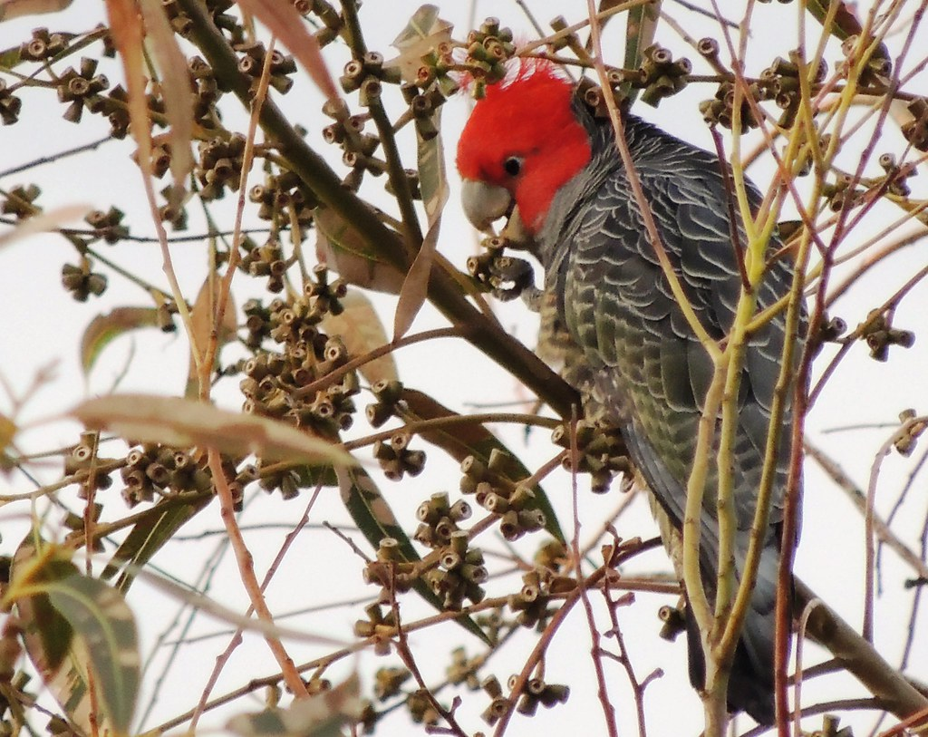
Gang-gang
Aboriginal group of origin: Wiradjuri.
Part of Australia: New South Wales.
Alternative Noongar spelling: not native to Wajuk country.
Part of speech: common noun, animal.

Slide 24
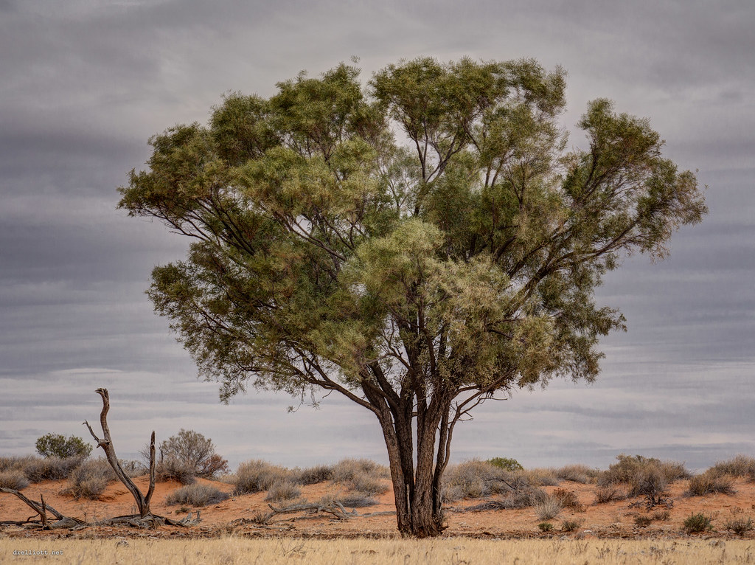
Gidgee
Aboriginal group of origin: Kalkadoon.
Part of Australia: Queensland.
Alternative Noongar spelling: also known as a spear.
Part of speech: common noun, plant.

Slide 25
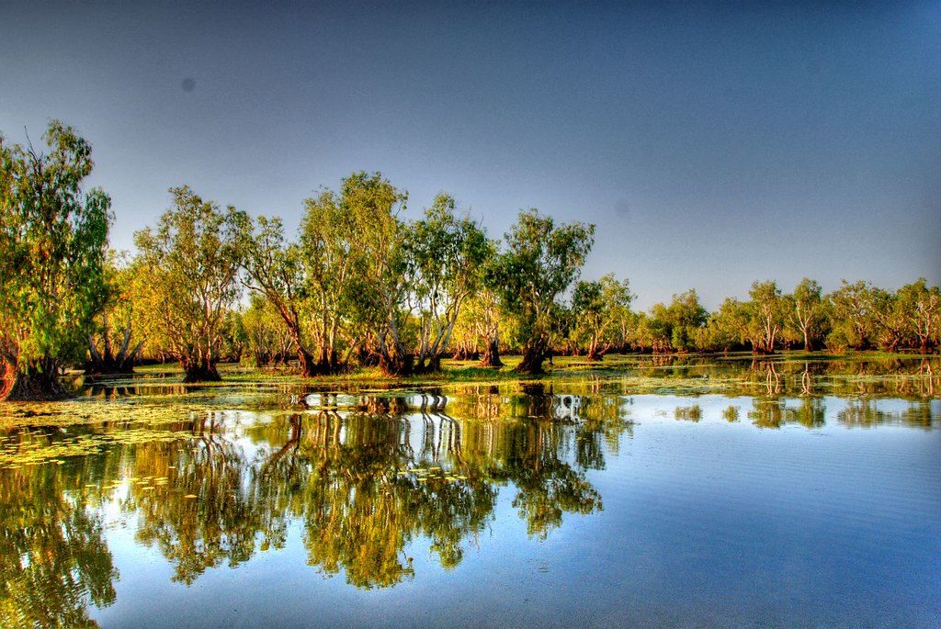
Billabong
Aboriginal group of origin: Wiradjuri.
Part of Australia: New South Wales.
Alternative Noongar spelling: uncertain.
Part of speech: common noun.

Slide 26
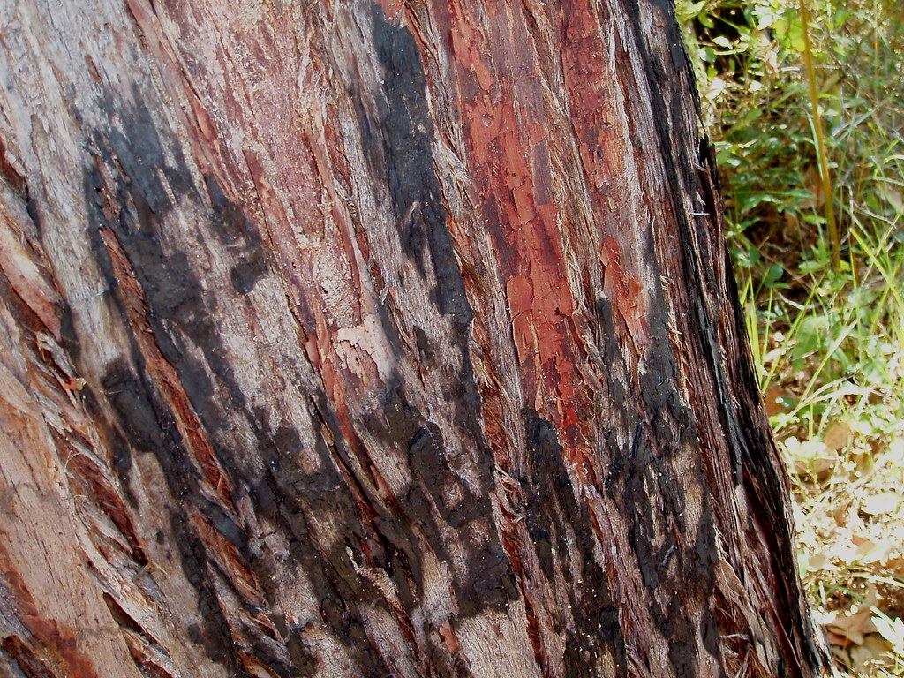
Jarrah
Aboriginal group of origin: Noongar people, Wadjuk country.
Part of Australia: Western Australia.
Alternative Noongar spelling: native to Wajuk country.
Part of speech: common noun, plant.

Slide 27
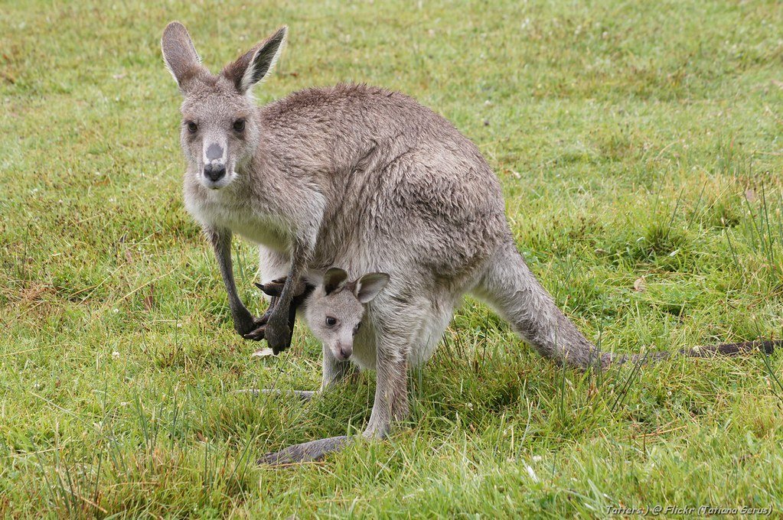
Kangaroo
Aboriginal group of origin: Guugu Yimithirr people.
Part of Australia: Queensland.
Alternative Noongar spelling: Yongka.
Part of speech: common noun, animal.

Slide 28
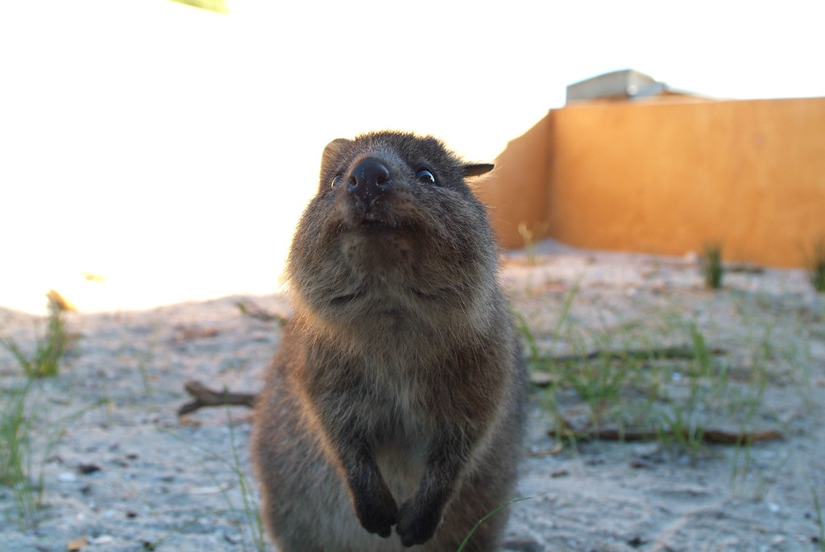
Quokka
Aboriginal group of origin: Noongar people, Wajuk.
Part of Australia: Western Australia.
Alternative Noongar spelling: Noongar in origin.
Part of speech: common noun, animal.

Slide 29
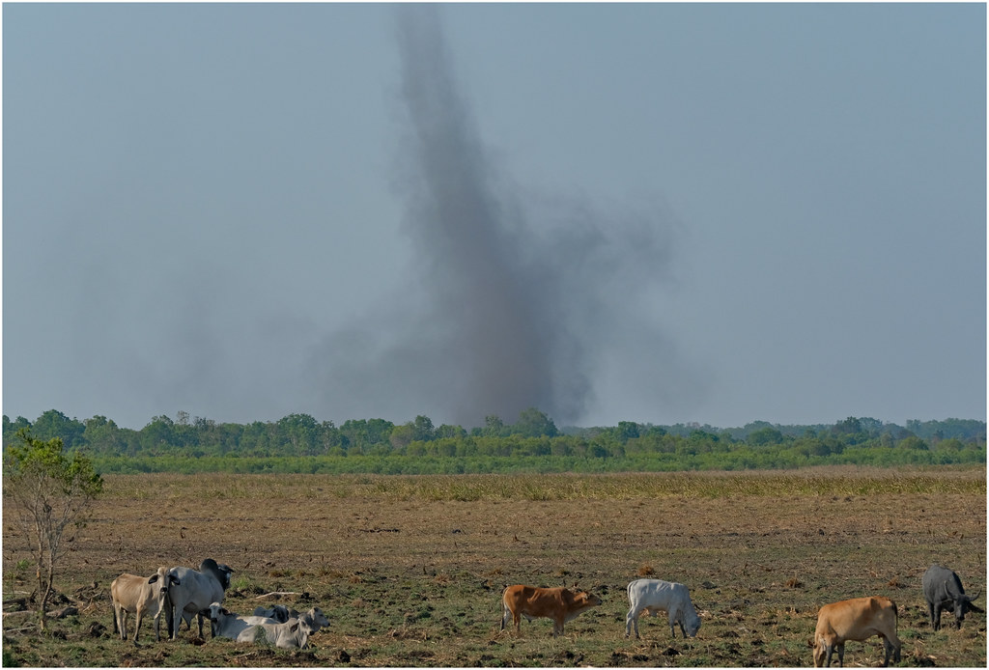
Willy Willy
Aboriginal group of origin: Yindjibarndi.
Part of Australia: Western Australia.
Alternative Noongar spelling: uncertain.
Part of speech: common noun.

Slide 30
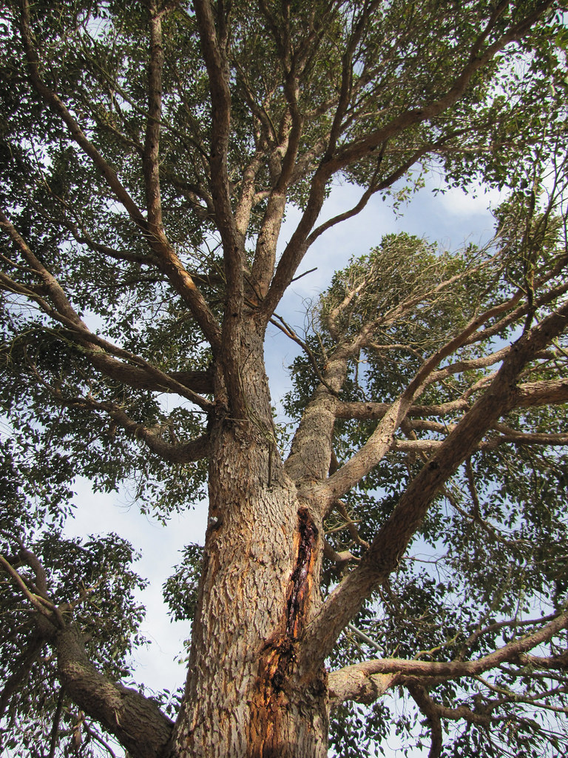
Marri
Aboriginal group of origin: Noongar.
Part of Australia: Western Australia.
Alternative Noongar spelling: Noongar in origin.
Part of speech: common noun, plant.

Slide 31
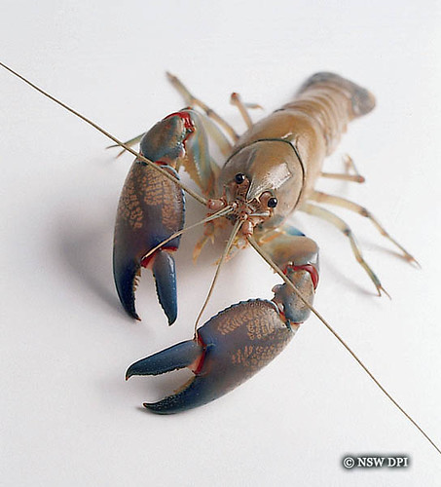
Yabby
Aboriginal group of origin: Wemba-Wemba.
Part of Australia: Victoria.
Alternative Noongar spelling: Gilgie.
Part of speech: common noun, animal.

Slide 32
Taipan
Burdardu
Kangaroo
Gidgee
Barramundi
Willy-willy
Bilby
Coolabah
Galah
Budgerigar
Brolga
Marri
Brigalow
Quokka
Bindii
Jarrah
Dingo
Gang-gang
Bunyip
Billabong
Yabby
Bogong

Slide 33
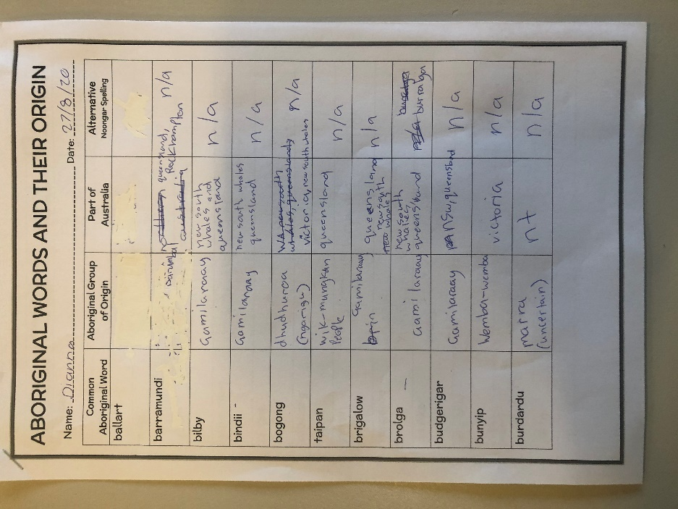
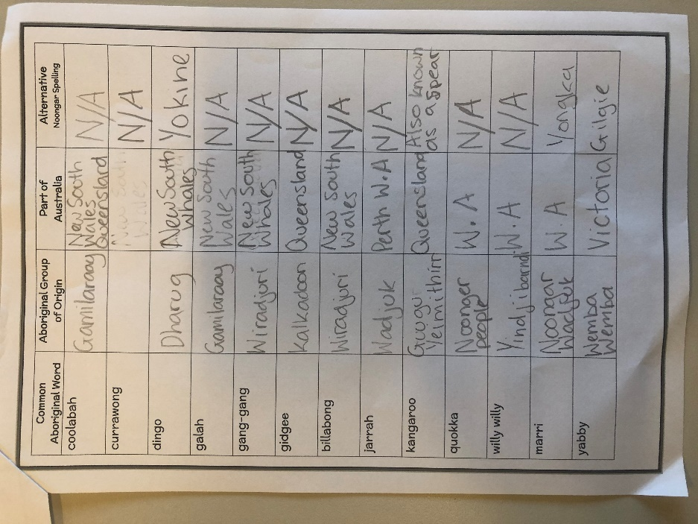
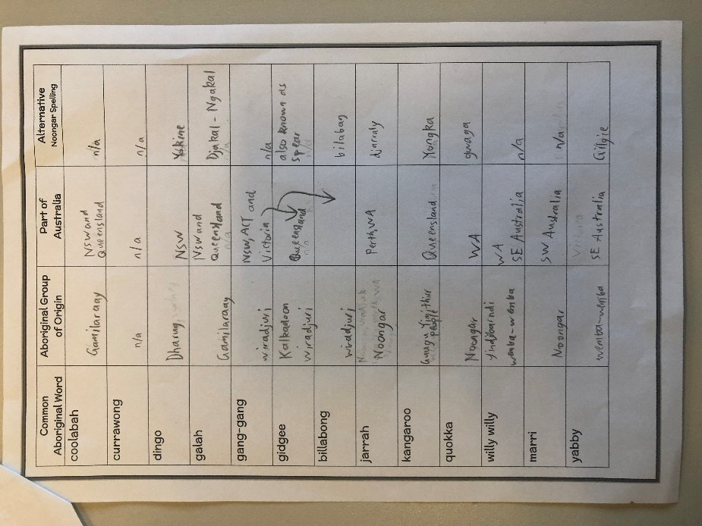
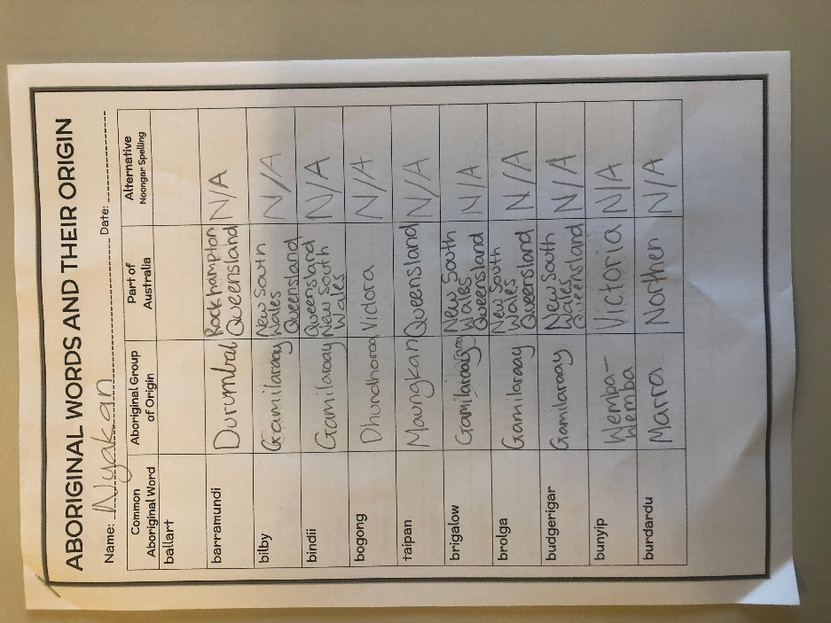
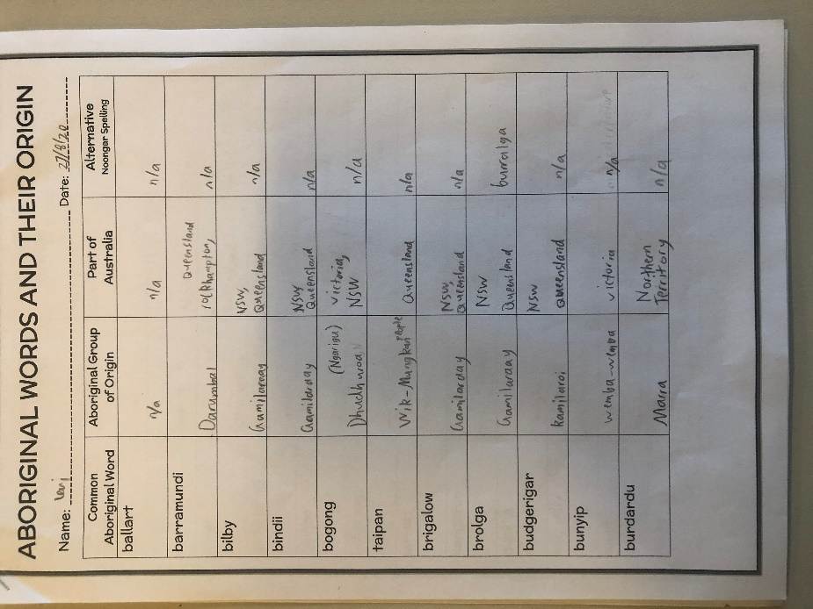
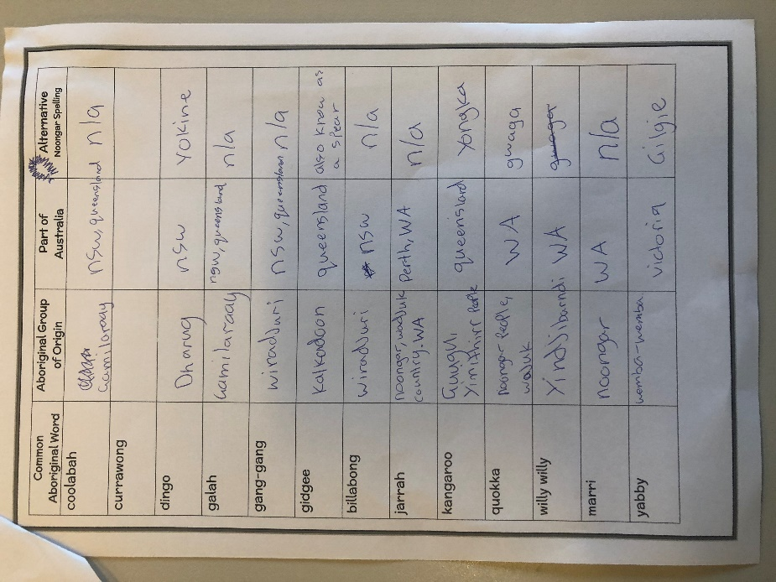
Work Samples

Slide 34
Special Thanks
Thanks to Noongar radio for hosting Koolangakas Takeover. This initiative has provided our classroom with the opportunity to explore the rich diversity of Aboriginal culture.

Slide 35
References
Aboriginal Australia Map - http://nationalunitygovernment.org/pdf/aboriginal-australia-map.pdf
List of Aboriginal Australia words commonly used in English
https://en.wikipedia.org/wiki/List_of_English_words_of_Australian_Aboriginal_origin
Barramundi
http://www.kasei.ac.jp/library/kiyou/2001/13.YOKOSE.pdf

Slide 36
References
Origin of Kangaroo
https://en.wikipedia.org/wiki/Guugu_Yimithirr_language
"Yabby" by NSW DPI Schools program is licensed under CC BY-NC-SA 2.0
"Saving a Marri Tree - Red Moon Sanctuary, Redmond Western Australia" by Red Moon Sanctuary
"Willy-Willy (Dust Devil) - Fogg Dam Conservation Reserve, Middle Point, NT, Australia.02" by Geoff Whalan
"Barramundi" by juanwei is licensed under CC BY-NC-ND 2.0

Slide 37
References
"Quokka" by hewball is licensed under CC BY-NC 2.0
"Jarrah Tree. Pemberton WA" by amandabhslater is licensed under CC BY-SA 2.0
"Kangaroo with joey inside the pouch (and some facts)" by Tatters ✾ is licensed under CC BY-NC-ND 2.0
"Bilby at Sydney Wildlife World" by D Coetzee is licensed under CC CC0 1.0Image
Bindii - "CAB010361a" by jerryoldenettel is licensed under CC BY-NC-SA 2.0

Slide 38
References
https://en.wikipedia.org/wiki/Gamilaraay
Bilby
https://en.wikipedia.org/wiki/Macrotis
Bogong - "Bogong Moth" by John Tann is licensed under CC BY 2.0
Brigalow - https://en.wikipedia.org/wiki/Acacia_harpophylla
Brigalow - "IMG_2003 Brigalow" by MargaretDonald is licensed under CC BY-NC-ND 2.0
"Brolga" by birdsaspoetry is licensed under CC BY-NC-SA 2.0

Slide 39
References
https://en.wikipedia.org/wiki/Bunyip
http://search.slv.vic.gov.au/MAIN:SLV_VOYAGER1770161
"Budgerigar (Melopsittacus undulatus)" by David Cook Wildlife Photography is licensed under CC BY-NC 2.0
https://en.wikipedia.org/wiki/Eucalyptus_coolabah
"Coolabah Tree" by jwbenwell is licensed under CC BY-ND 2.0

Slide 40
References
"Dingo" by Carlos López Molina is licensed under CC BY-NC-ND 2.0
https://en.wikipedia.org/wiki/Galah
https://incubator.wikimedia.org/wiki/Wp/nys/Djerap_(Birds)
"Galah" by 0ystercatcher is licensed under CC BY-NC-SA 2.0
"Gang gang cockatoo (male - Scientific Name: Callocephalon fimbriatum) a rare find indeed!" by PsJeremy is licensed under CC BY 2.0

Slide 41
References
https://en.wikipedia.org/wiki/Acacia_cambagei - Gidgee
"Gidgee tree" by drelliott0net is licensed under CC BY 2.0
https://www.cherneesutton.com.au/pages/gidyea-or-gidgee-tree
"Australia - Yellow Waters Billabong" by pedro_qtc is licensed under CC BY-NC-SA 2.0
https://slll.cass.anu.edu.au/centres/andc/meanings-origins/y - Yabby

